Slide 1


General Meeting 02.02.2023

Slide 2


This January
I’ve read up on topics so that I can cite for my thesis. I started writing the theory and method chapters.
These chapters are the slowest to be written (because of citations)
I also used a significant amount of time to read in the source so that I could quality check my understandings + have a citation to the correct place
Machine Learning – Tom Mitchell
Seismic Data Analysis – Özdogan Yilmaz
Geophysics of Reservoir and Civil engineering – Mari et al.
I have 5 ½ pages of densely packed text written

Slide 3


Trashcan
Transfer learning – I still have not done any of this. May relegate to proposed continued work.
Synthetic data is in time domain. CPT is in depth domain
Multitask learning?
The seismic has a much more «wavy» nature than the AI, might be harder to create meaningful abstractions for the network. If I trash it, should I report on it at all? Would require addition to theory chapter
2D?
Padding issue. Not sure what mustafa did for this, but It does not seem like he encountered any issues with it.
May be caused by degradation because of the deep network

Slide 4

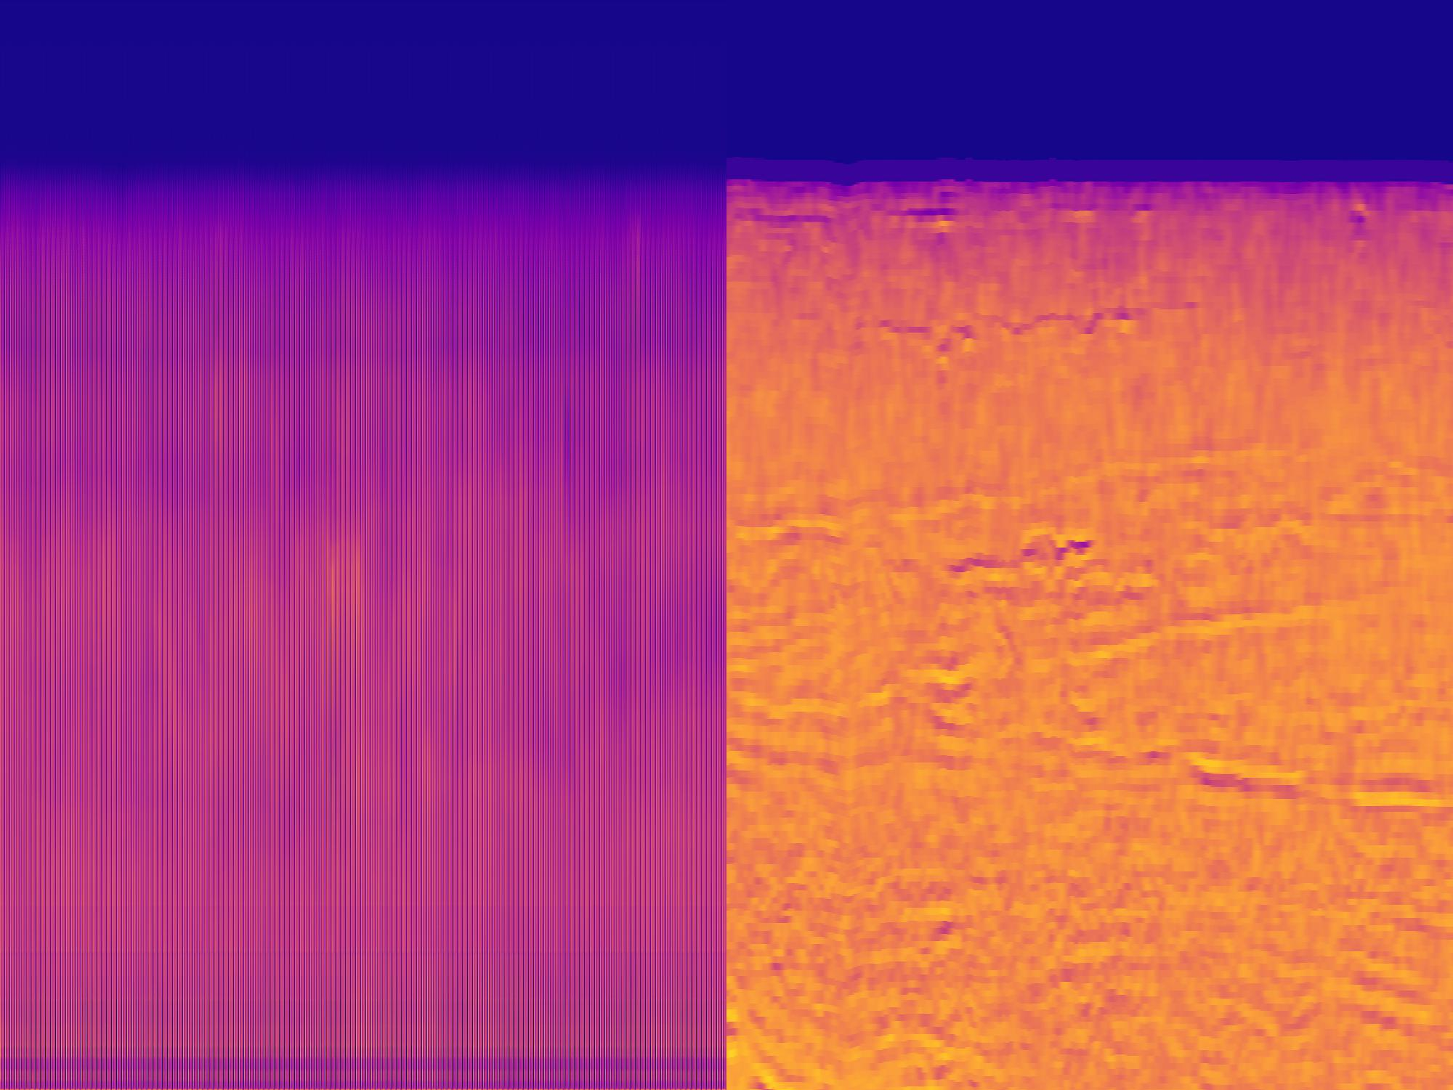
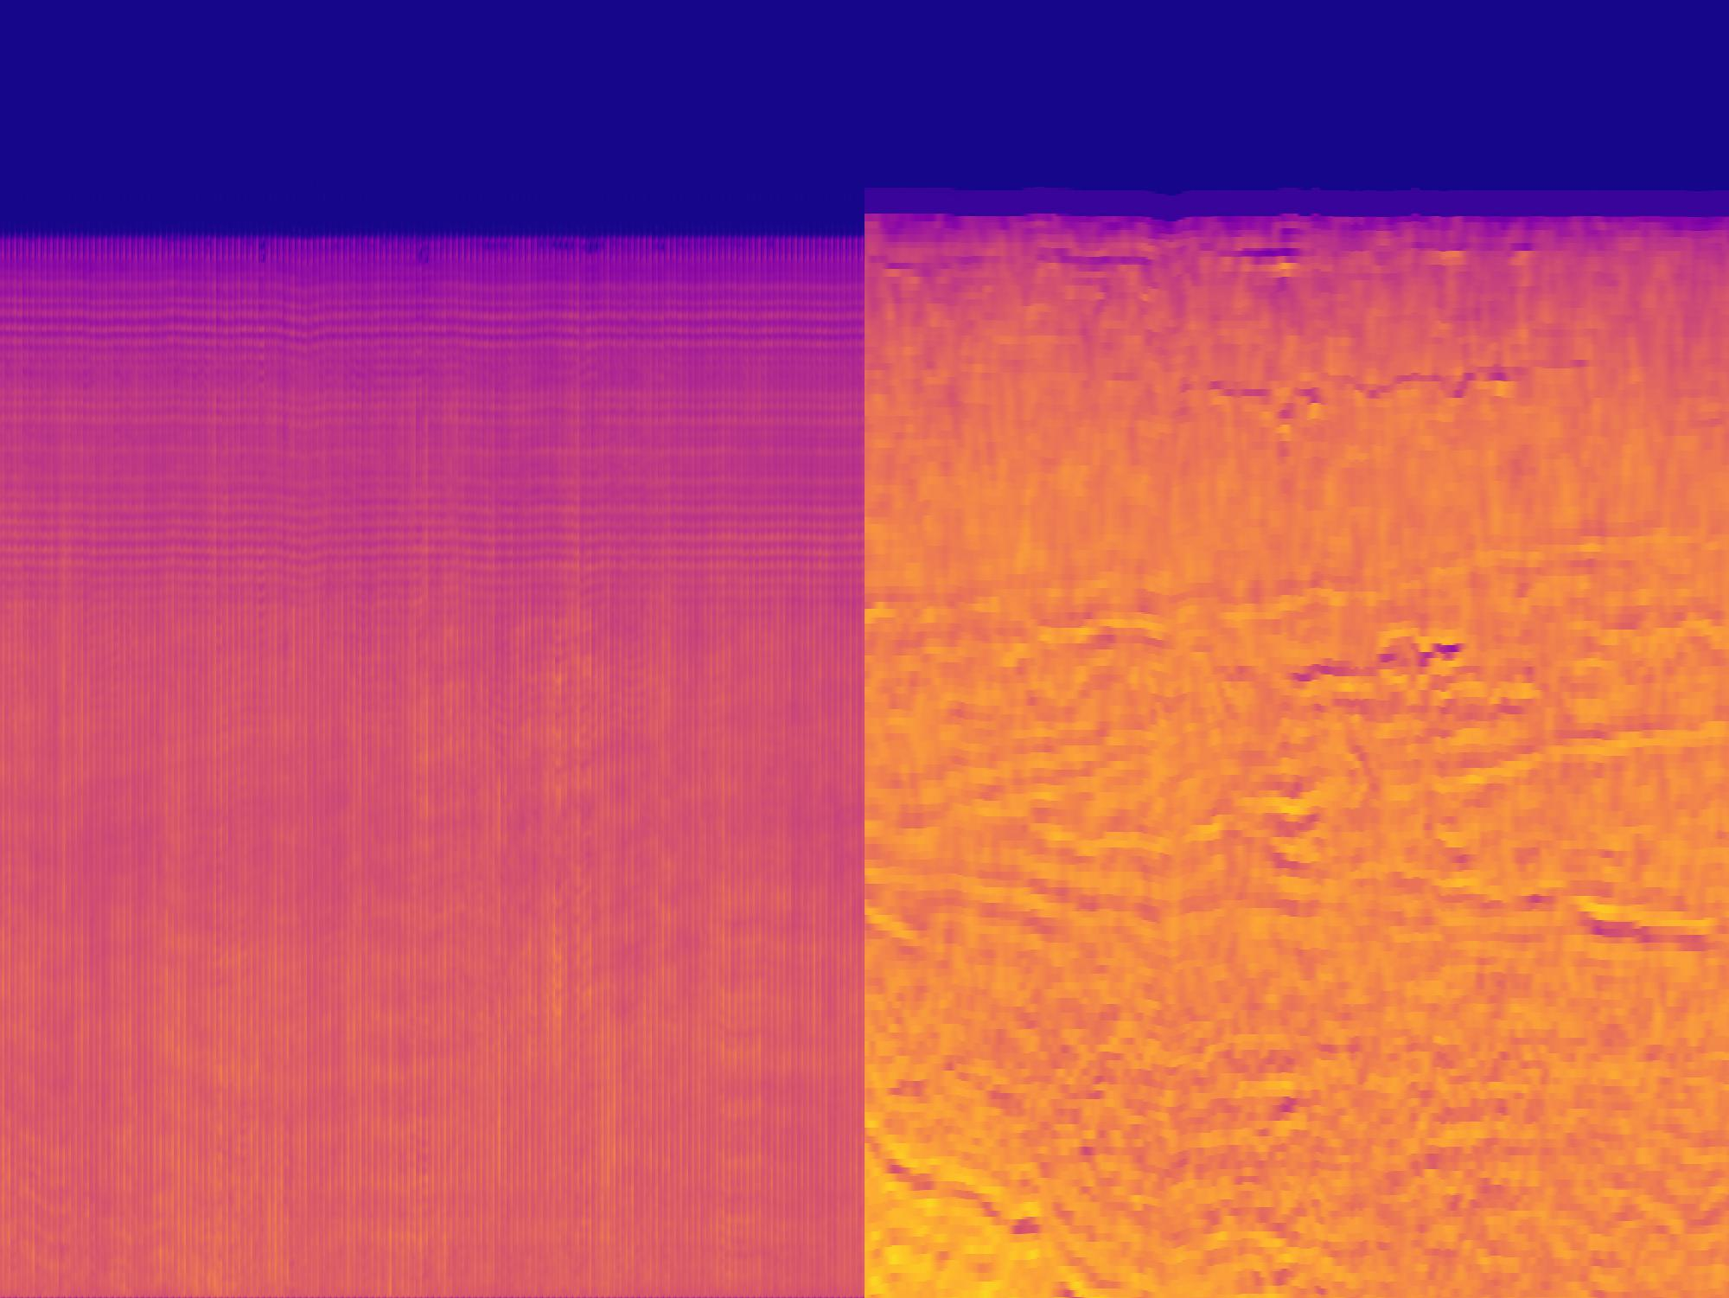
Edge values are lower, and longer running time seems to dissipate the prediction
ADX/0:
nb_filters = 12
kernel_size = (3, 5)
group_traces = 7
tcn_stacks = 1
reg_stacks = 3
epochs = 125
ADX/1:
nb_filters = 8
kernel_size = (3, 5)
group_traces = 7
tcn_stacks = 1
reg_stacks = 3
epochs = 117

Slide 5
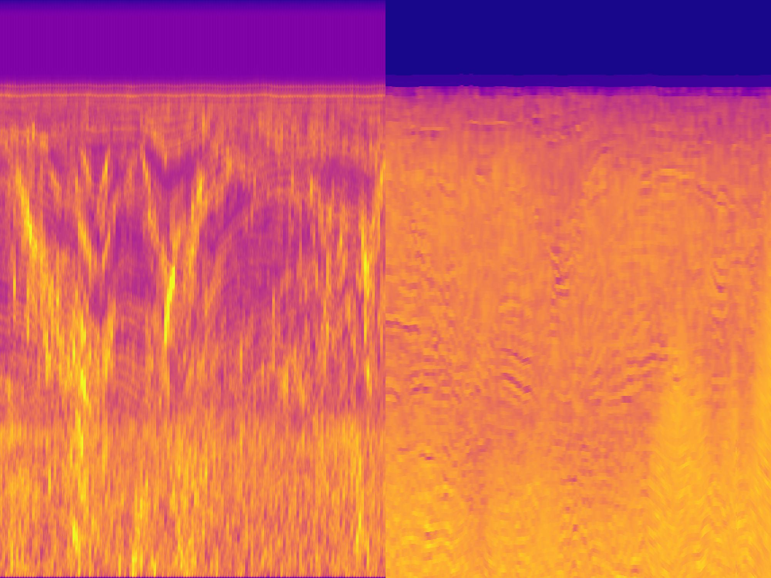
More variety for low epochs
ADO/0:
nb_filters = 4
kernel_size = (4, 4)
group_traces = 7
tcn_stacks = 1
reg_stacks = 3
epochs = 1

Slide 6
Padding for 2D
Only padding on top and bottom
0 | 4 | 2 | 6 | 0
0 | 8 | 9 | 1 | 0
0 | 5 | 8 | 3 | 0
0 | 4 | 2 | 1 | 0
0 | 8 | 2 | 6 | 0
0 | 3 | 7 | 1 | 0
36 | 46 | 29
36 | 41 | 24
29 | 39 | 22
26 | 34 | 19
30
46
41
39
34
27
(3x3)
Kernel
1 | 1 | 1
1 | 1 | 1
1 | 1 | 1
Edge effects caused by zero-padding. More pronounced for bigger kernels
I would like to have no padding, but tf asymmetric padding requires implementation.
I would like to use the neighboring traces to reduce the dimensionality down to 1

Slide 7

Padding for 2D
4 units
18
33
23
20
21
18
17
23
21
21
21
15
4 | 2 | 6
8 | 9 | 1
5 | 8 | 3
4 | 2 | 1
8 | 2 | 6
3 | 7 | 1
7
14
11
10
9
8
? | ? | ?
 | ? | ?
 | ? | ?
$$z_{1}$$
$$z_{2}$$
$$z_{3}$$
$$z_{4}$$
$$z_{5}$$
$$z_{6}$$
30
46
41
39
34
27
(4x3x3)
Kernel
? | ? | ?
 | ? | ?
 | ? | ?
? | ? | ?
 | ? | ?
 | ? | ?
1 | 1 | 1
1 | 1 | 1
1 | 1 | 1
Edge effects caused by zero-padding. More pronounced for bigger kernels
I would like to have no padding, but tf asymmetric padding requires implementation.
I would like to use the neighboring traces to reduce the dimensionality down to 1
3 width size kernel reduces width dimension by 2 for each pass

Slide 8

Proposed method
Local seismic
Use genetic algorithm to invert for AI around CPT locations
Invert for AI using TCN as feature extractor
Use latent space units in place of the seismic attributes in tree model
This method requires less data to be quality controlled. Only one AI trace per borehole location.
AI predictions can be compared to the fully inverted data
Single AI & CPT trace

Slide 9
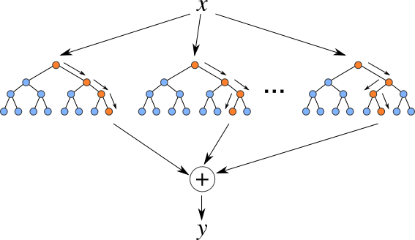
Proposed method
Random Forest vs. Gradient boosting methods
Tensorflow has tfdf, but it’s only available on linux
Until now the TCN has inherited from the keras.layer class
Some rewriting is required to turn into keras.model class for access to the latent space vector
JR already did this, so he has input on how doable it is
It may be examined whether the seismic attributes perform better than learned ones.
Instead of focusing on hyperparameter tuning, I want to compare the methodologies. Hyperparameters should stay similar for comparison

Slide 10



CPT prediction
4 units
$F( , , , , )$ = ($q_{c, 1}, f_{s, 1}, u_{2, 1}$)
$$z_{1}$$
30
7
18
17
18
33
23
20
21
18
17
23
21
21
21
15
7
14
11
10
9
8
$$z_{1}$$
$$z_{2}$$
$$z_{3}$$
$$z_{4}$$
$$z_{5}$$
$$z_{6}$$
30
46
41
39
34
27
Can the machine learning learn better attributes than the ones used for prediction on TNW?
Using attributes for AI inversion
Will need to use Random Forest, for comparison
Want to use gradient boosted tree model, because of Keras compatibility
May be possible to train the feature recognition on CPT gradients
Latent space representation

Slide 11
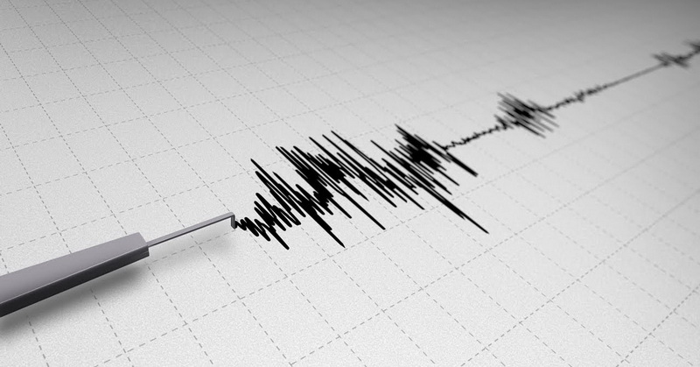
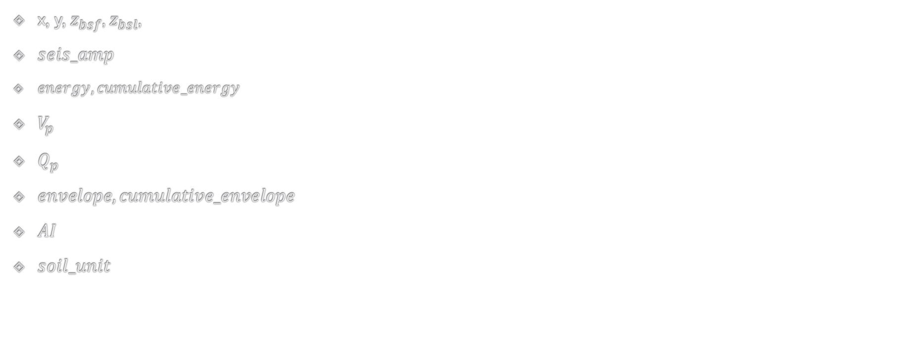
CPT prediction with Seismic Attributes
${\text{x}\text{, }\text{y}\text{,} z}_{bsf}$, $z_{bsl}$,
$seis_amp$
$energy, cumulative_energy$
$V_{p}$
$Q_{p}$
$envelope, cumulative_envelope$
$AI$
$soil_unit$
$$F\left(z_{bsf}, z_{bsl}, seis_amp, energy, cumulative_energy, V_{p}, Q_{p}, envelope, cumulative_envelope, AI, soil_unit\right)=\left(q_{c}, f_{s}, u_{2}\right)$$

Slide 12
Discussion chapter
More units is not necessarily better for prediction accuracy with RF. Bad units get sampled as much as good ones. Therefore the amount of units provided is of interest. Should I select the same amount as the seismic attributes?
The inclusion of neighboring traces (2D) is more comparable to 1D when the traces are boiled down to 1 trace for AI
The reconstruction module may not be useful
Growing in the amount of units as the trace dimension is lowered has been done in other papers
Increasing the amount of filters is incompatible with skip connections, which is another argument for not bothering with the seismic reconstruction

Slide 13

Transfer learning
The regression module processes these activations to produce the final property log at the well position. However, the reconstruction module uses them to reconstruct the input seismic image. This is an example of multitask learning in which the network is learning two tasks at once: property log estimation and seismic input reconstruction. By sharing representations between the two tasks, especially if they are related to each other, we bias the network to learn more generalizable features.
- Mustafa et al. 2021

Slide 14
Roadmap
February
March
April
The rest of Theory and method should be written completely.
Everything should be set for acquiring results in February.
Programming should be finished
Regional geological description
Figures must be made. Or rcParams set up for result plots.
Results should be thouroughly written about in the results part.
Hereafter they will need discussion in the Discussion section.
Conclusions chapter is written
Introduction is written.

Slide 15
May
Abstract gets written
Preface gets written
Writing, proofreading
Feedback is wanted: harsh criticism
DUE DATE: 15.05.2023
DEFENCE: 01.06.2023

Slide 16

Continued work
Self attention mechanisms for the CPT prediction
Transformers instead of trees
Latent space clustering for unsupervised classification
Seismic facies recognition (image segmentation)
Transfer learning from training on synthetic data
2D methods?

Slide 17
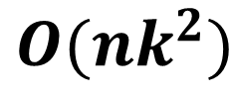
Topics of discussion
How to visualize findings in figures
Prediction scatterplots
Plotting traces
Using KL divergence to compress info about prediction distribution?
The effect of resampling the seismic on the data
Frequencies are then removed which may carry info? May be something for discussion part
What tree model(s) should be used?
Switching to WSL, on both desktop and NGI computer
One main motivation for these methodologies are the speed increase of neural networks as opposed to the genetic algorithm; How to measure this? How to report this? => Time complexity?
I want to use time complexity for evaluating the proposed method against the genetic algorithm; I need an estimate for the time complexity of the genetic algorithm used for TNW
$$O(nk^{2})$$

Slide 18
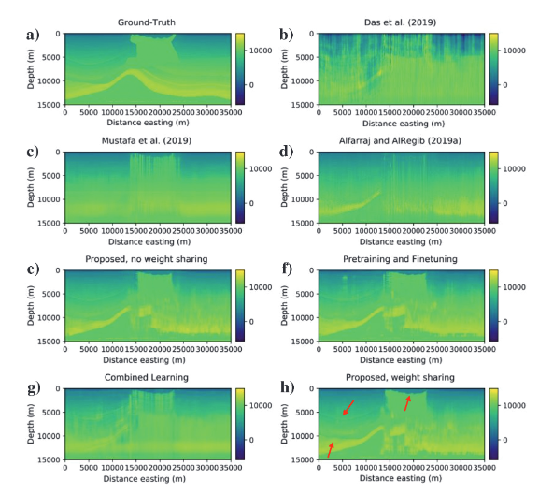
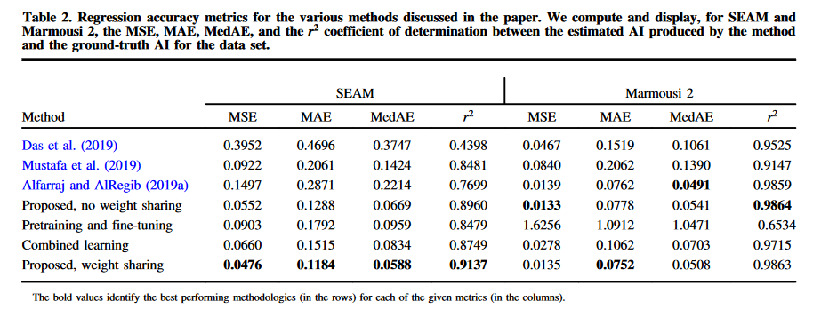
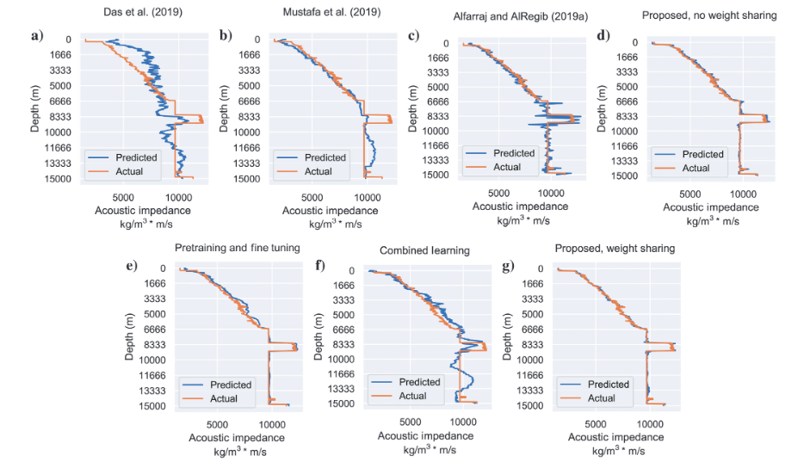
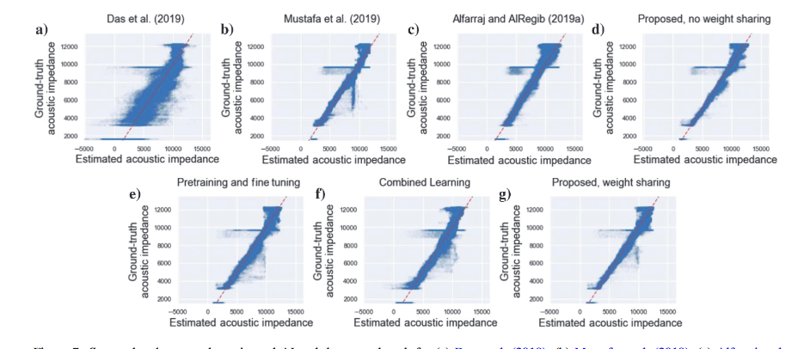
Figures
Prediction Image
Loss table
Prediction vs true trace
Prediction scatterplot

Slide 19
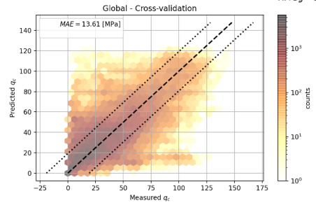
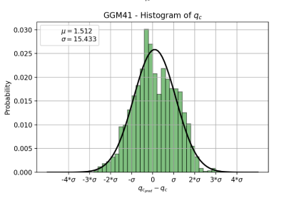
CPT prediction
Cross validation scatter plots [hexagonal?]
Error histogram

Slide 20
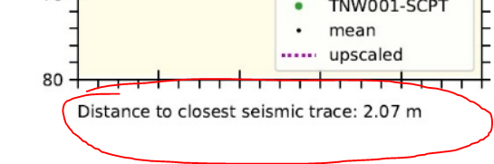
Time saves
↑ From TNW IGM report
I would like to have the code that correlates the CPTs to the seismic traces

